Slide 1

DATA SCIENCE
Prof. Jean Paul Barddal

Slide 2
Exploratory data analysis versus explanatory data analysis

Slide 3
Exploratory analysis vs. Explanatory analysis
Exploratory
Analysis conducted when we need to understand the data
Questions are made and we answer them using statistics or visualizations
Visualizations are not perfect
Explanatory
Aims at “polishing” the results of the explatory analysis
Highlights the insights obtained
Is often coupled with a story or demand

Slide 4
Steps
Data extraction
Data cleansing
Exploratory analysis
Data analysis
Sharing

Slide 5
I have a dataset and I need to present it to someone else.
How can I do so, effectively?

Slide 6
Analyze the following image.
You will have 4 minutes to take notes abou it
and you will be asked about it

Slide 7
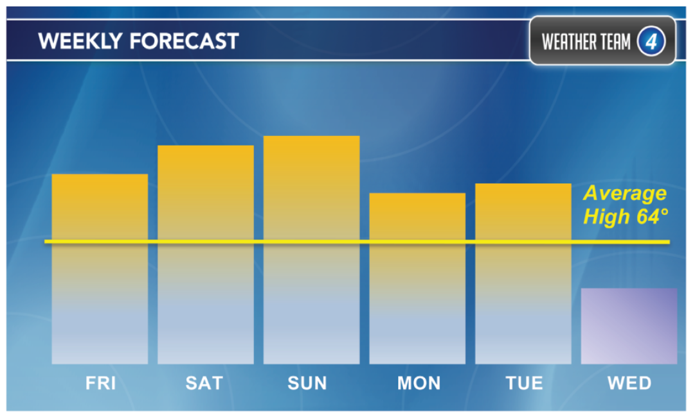

Slide 8
What temperature would you estimate for Sunday?

Slide 9
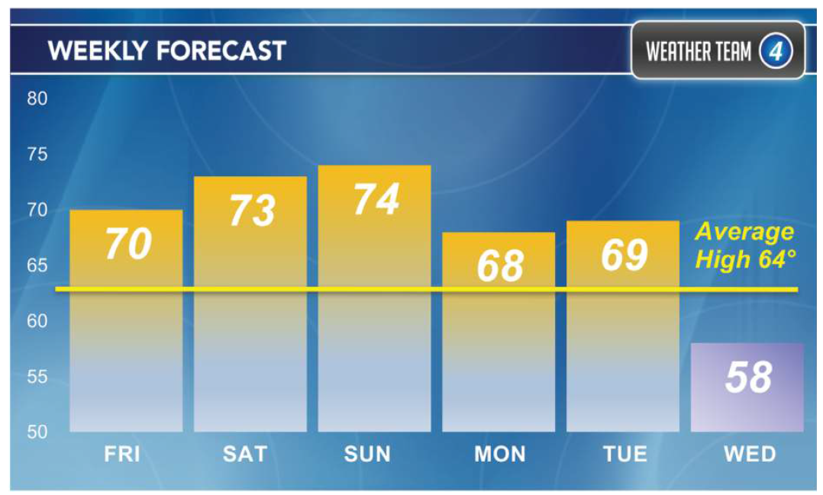

Slide 10
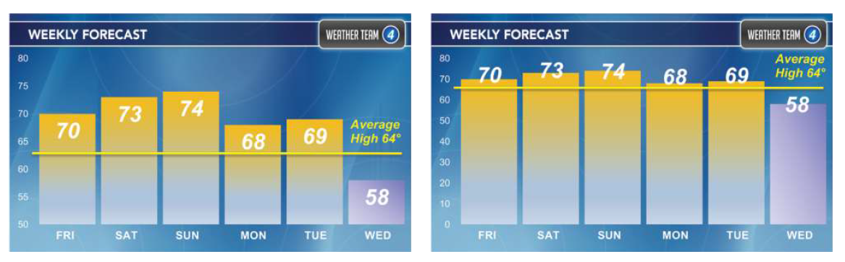

Slide 11
EFFECTIVE DATA VIZualization

Slide 12
Effective data visualization
Visualizations are means to communicate, and thus, we must ensure that the reader acknowledges the same information we intended to divulge
Suggestion: triple-check the checklist that comes next
We will work on this topic following a “reductio ad absurdium” approach in the sense that we will check what should NOT be done

Slide 13
Checklist
Title
Axes labels
Axes units
Legend
Scale
Order
Colors
Text size
Chart junk
On Blackboad we have Evergreen’s
checklist with more details!

Slide 14
POOR DATA VISUALIZATION

Slide 15
What deems a visualization poor?
A visualization is poor if our message is unclear
This means we should avoid:
Ambiguity
Lack of information
Omission
Distraction

Slide 16
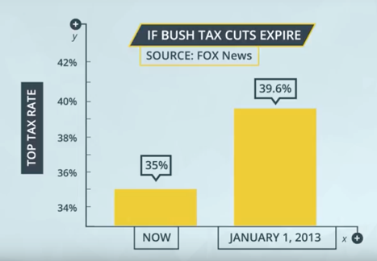
Example
The difference between the bars is somewhat small, but the scale makes us believe the difference is huge

Slide 17
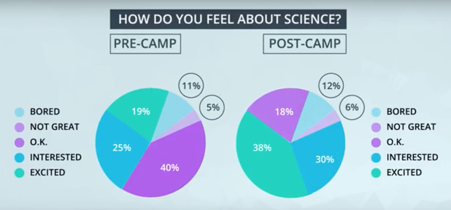
Example
Is it possible to say that the interest in science increased with the camp?

Slide 18
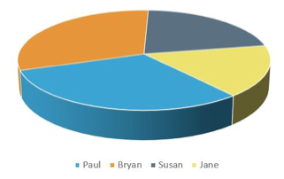
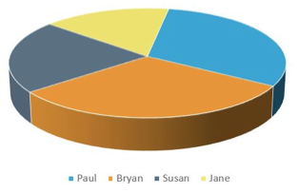
Example
Which of the regions below is larger?
Bryan or Paul?
What about here?

Slide 19
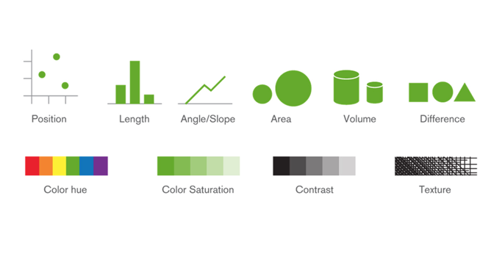
Visual components
Data visualizations are tailored using the following components:

Slide 20
Chart Junk
When deciding which components we should use, it is a good idea to think about what NOT to use
Tufte created the "data-ink ratio” concept, which is the relation between the ink required to plot the data and the ink used for the rest

Slide 21
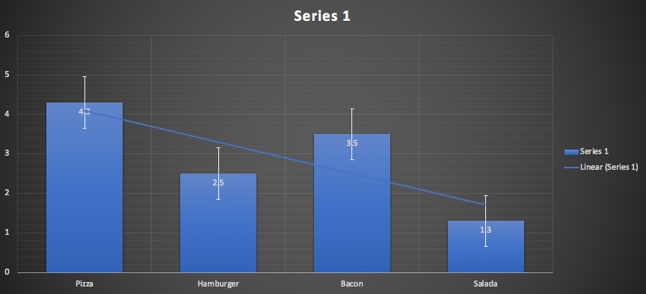
Chart Junk

Slide 22
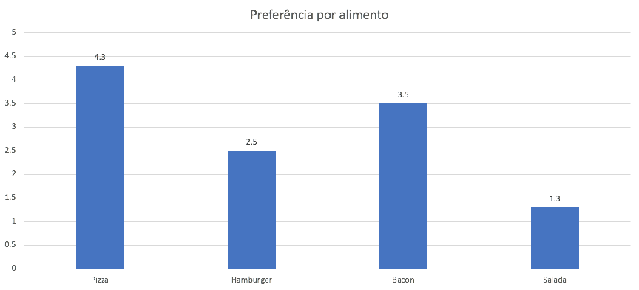
Chart Junk

Slide 23
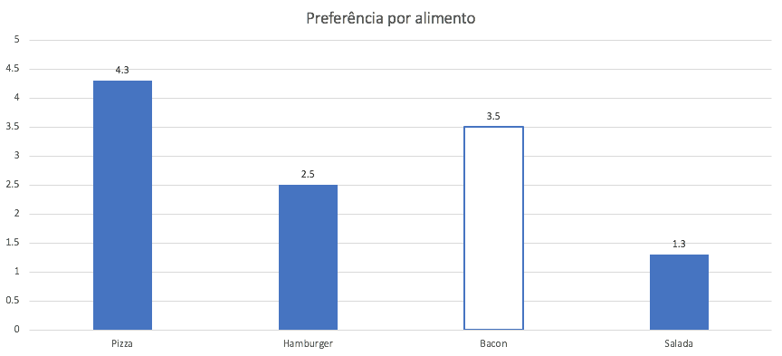
Chart Junk
Colors can be used to highlight something!

Slide 24
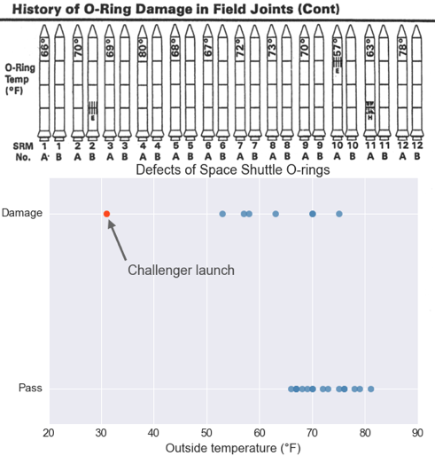
Chart Junk
What is your feeling about these plots?

Slide 25
ANALYSIS

Slide 26
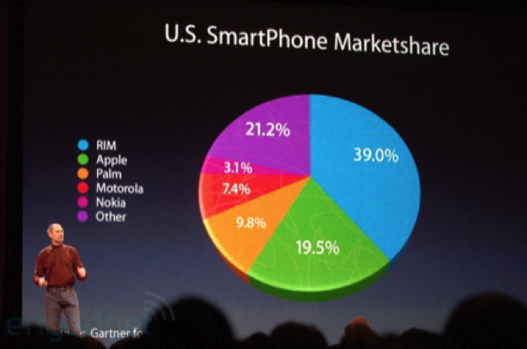
What problems do you see here?

Slide 27
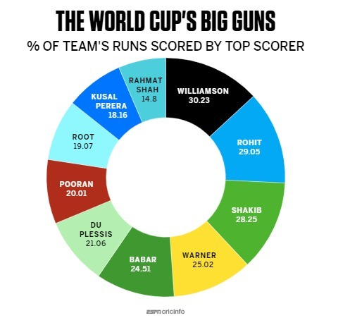
And here?

Slide 28
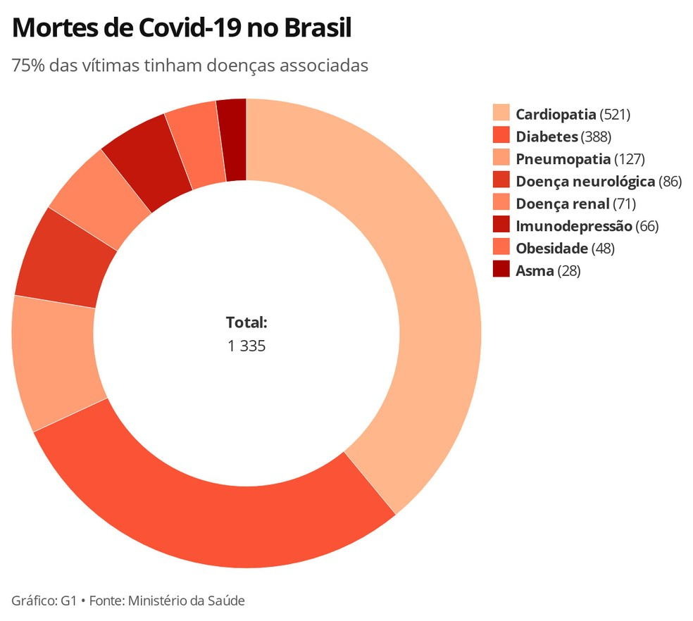

Slide 29
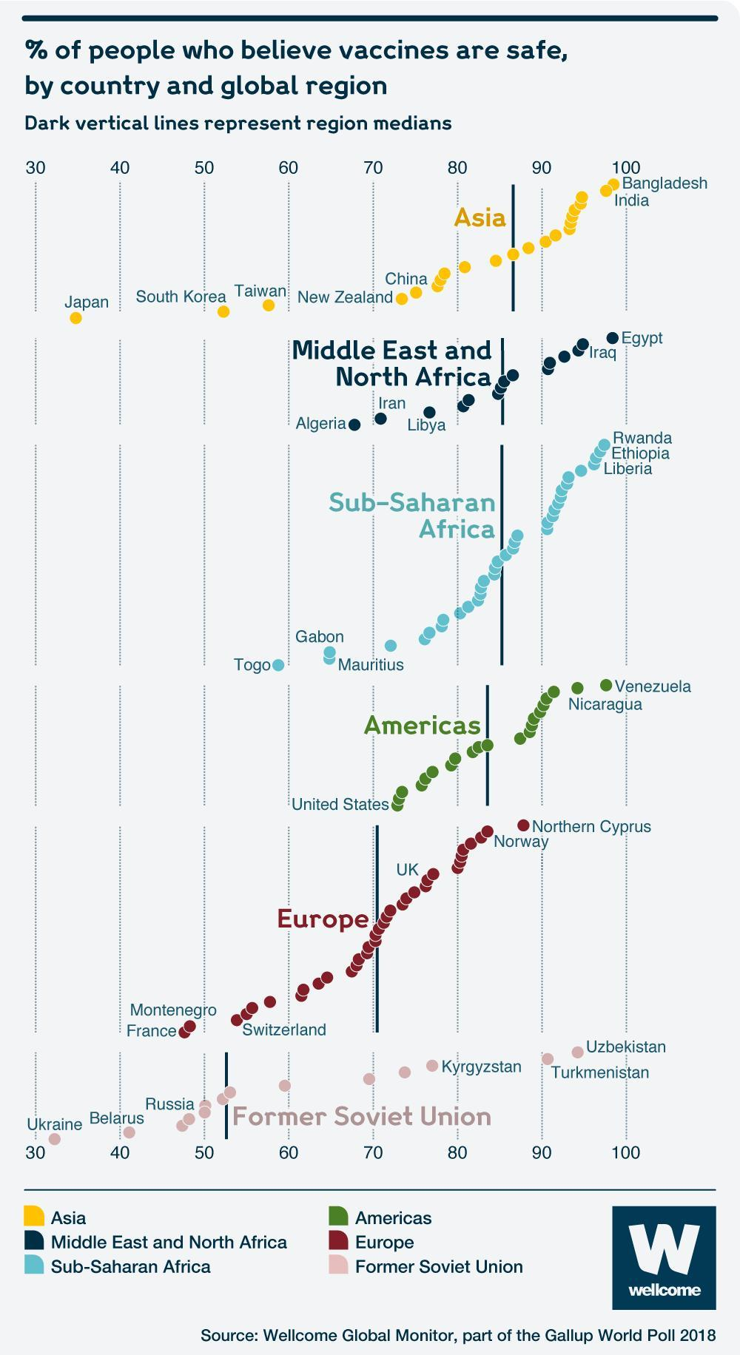

Slide 30
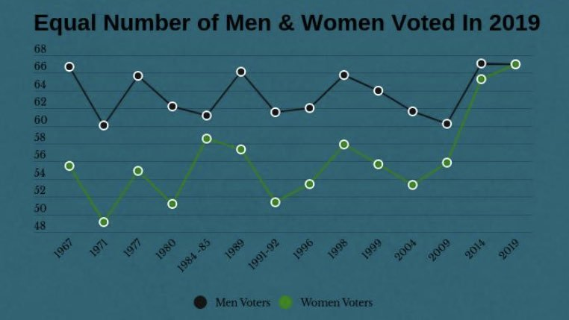

Slide 31
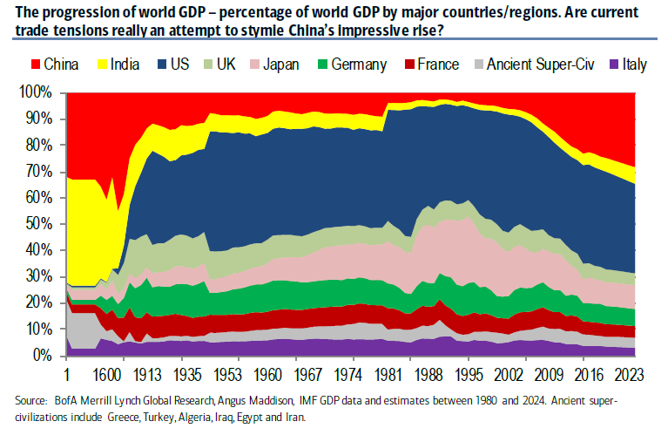

Slide 32
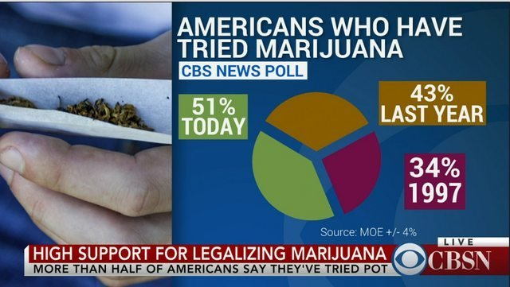

Slide 33
References
Most of these visualizations were obtained from
https://badvisualisations.tumblr.com/

Slide 34
Gestalt PRINCIPLES

Slide 35
Gestalt principles
Proximity (Proximidade)
Similarity (Similaridade)
Enclosure (Cerceamento)
Closure (Fechamento)
Continuity (Continuidade)
Connection (Conexão)
Take notes, we will use names in a few moments.

Slide 36

Proximity
Things that are closer to one another are perceived as belonging to a same group
Notes:
Iamgem from: https://www.toptal.com/designers/ui/gestalt-principles-of-design

Slide 37
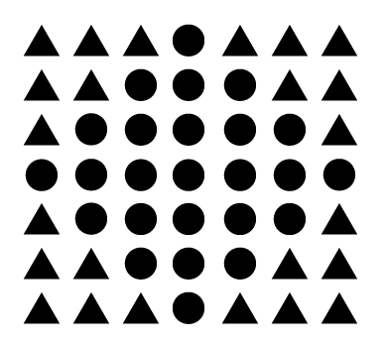
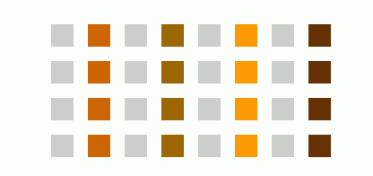
Similarity
Objects that share shapes, sizes, colors or orientation are perceived as belonging to the same group
Notes:
Imagem from: https://www.usertesting.com/blog/gestalt-principles

Slide 38
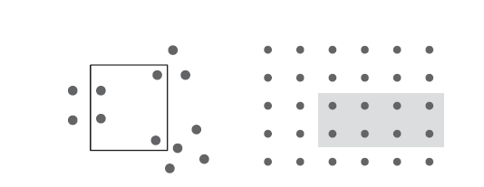
Enclosure
We observe objects that are enclosed together as belonging to the same group
Notes:
Imagem from: https://www.usertesting.com/blog/gestalt-principles

Slide 39


Closure
We perceive objects as a whole even though some parts are missing.
Notes:
Imagem from: https://www.usertesting.com/blog/gestalt-principles

Slide 40

Continuity
Our eyes seek the most “natural” and “smooth” path between objects, even though they may not exist
How would you separate these items?
If you see many ways, draw them all (3 minutes)
Notes:
Imagem from: https://www.usertesting.com/blog/gestalt-principles

Slide 41

Continuity - 1
Notes:
Imagem from: https://www.usertesting.com/blog/gestalt-principles

Slide 42

Continuity - 2
Notes:
Imagem from: https://www.usertesting.com/blog/gestalt-principles

Slide 43

Connection
We tend to perceive connected objects as a group
Connection is often stronger than color, shape or size
Notes:
Quantos objetos tem na imagem?

Slide 44
Analyze the following visualization (5 minutes).
Next, you will be asked a (tough) question about it and the gestalt principles.

Slide 45
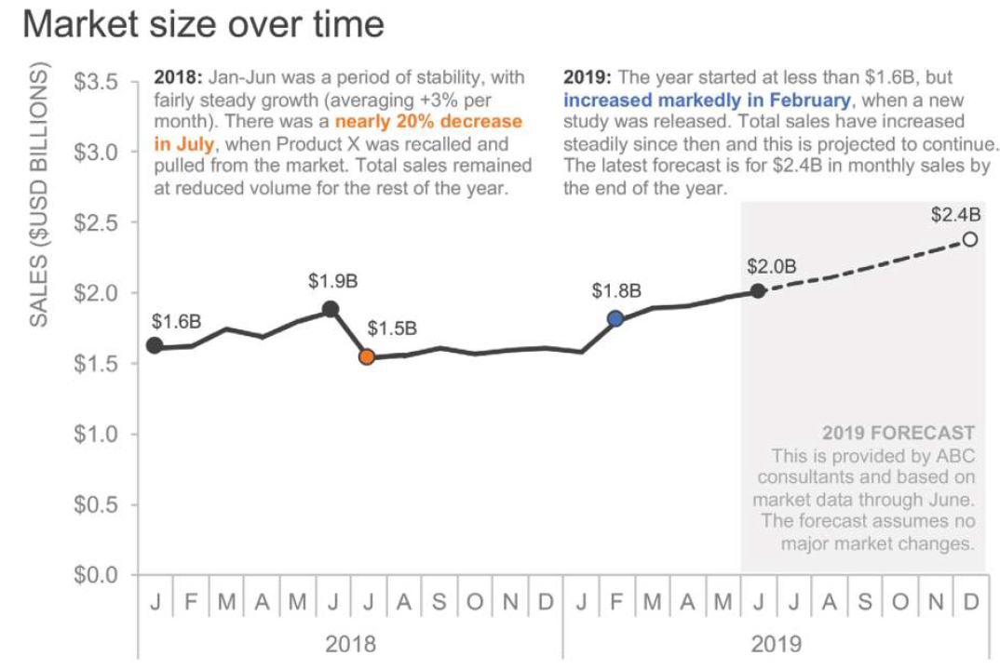
Notes:
How many principles and where activity.

Slide 46
WHICH Gestalt principles have been used? GO TO DISCORD AND DISCUSS IN GROUPS YOU NEED TO DELIVER YOUR NOTES AS AN ACTIVITY

Slide 47
Which gestalt principles have been used?
Proximity:
Indicates that the y axis, title and labels must be read together
Clarifies that the data labels and markers are related
Similarity:
The similarity of colors (orange and blue) with the text is used to connect things

Slide 48
Which gestalt principles have been used?
Enclosure:
The gray region is used to differentiate the forecasts from the historical values

Slide 49
Which gestalt principles have been used?
Continuity:
The dashed line is used to connect the forecasts in the right section of the plot
Connection:
In the line plot, all points are connected and make the trend easily visible

Slide 50
Which visual components would you change in the following visualization? (5 min)

Slide 51
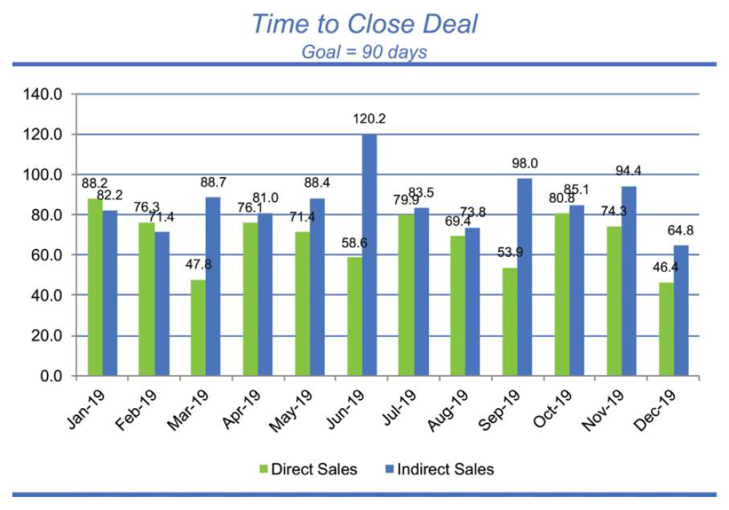

Slide 52
1. Removing the external blue lines
The lines between the title and the plot, as well as the most external line are unnecessary
The enclosure principle allows us to visualize the plot without them

Slide 53
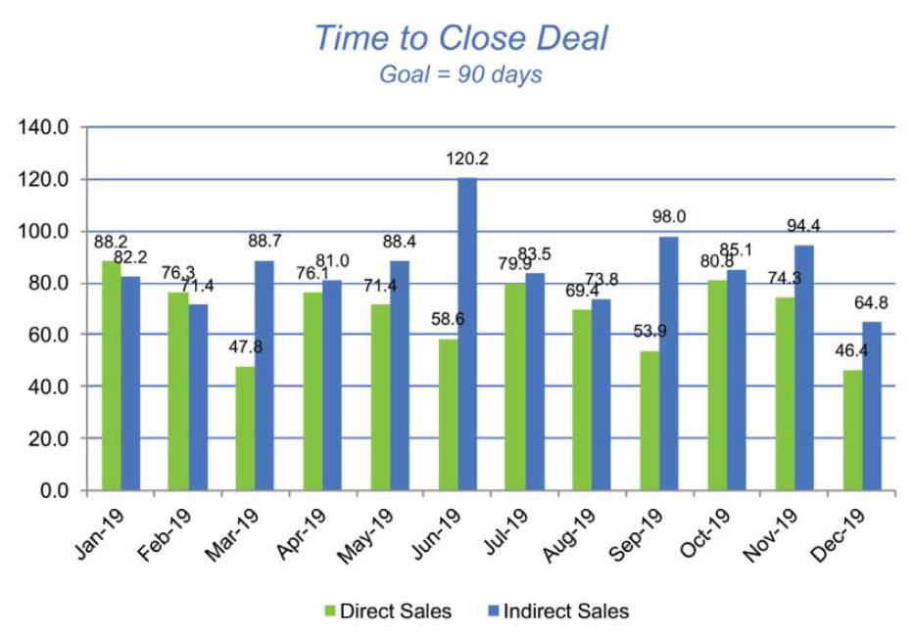

Slide 54
2. Remove the grid lines
Removing the grid lines, our attention is drawn to the data

Slide 55
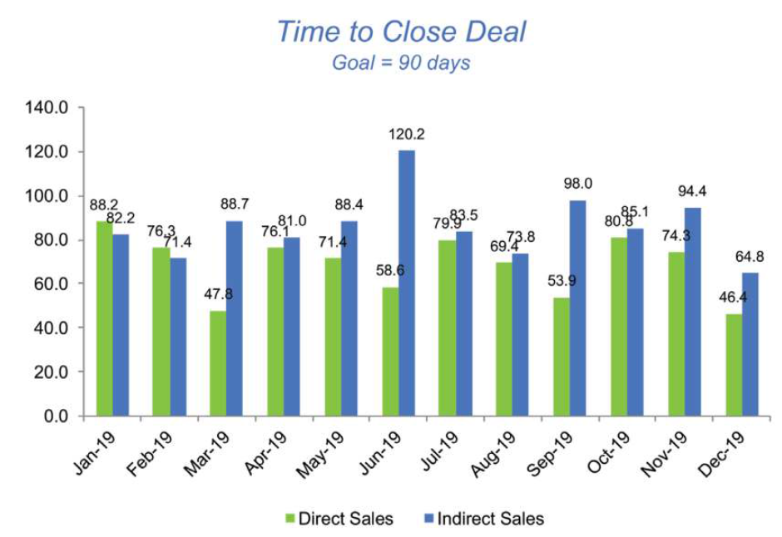

Slide 56
3. Remove the zeroes from the y axis
The extra zeroes in the decimal places are not required
It is also interesting to change the y axis scale for 15-day intervals

Slide 57
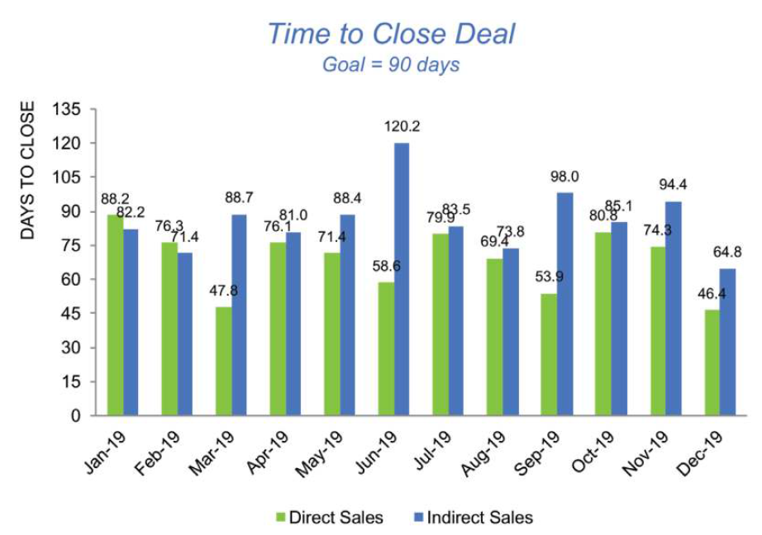

Slide 58
4. Eliminate diagonal texts in the x axis
Diagonal and vertical texts are polemic
Whenever possible, prefer horizontal texts

Slide 59
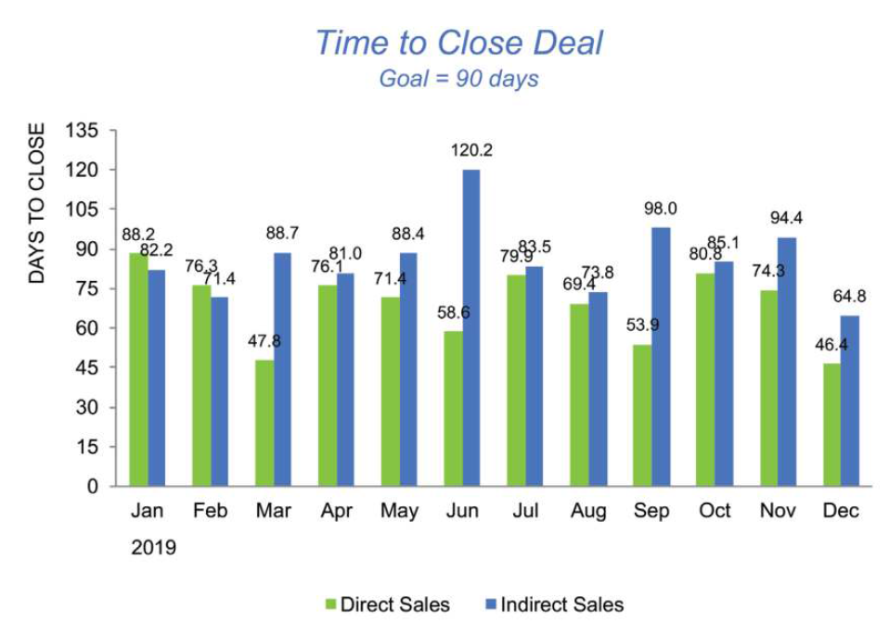

Slide 60
5. Decrease blank spaces
Avoid having unnecessarily big blank spaces between bars
Useful due to the connection principle
A good practice, however, is to keep blank spaces between bars from different categories

Slide 61
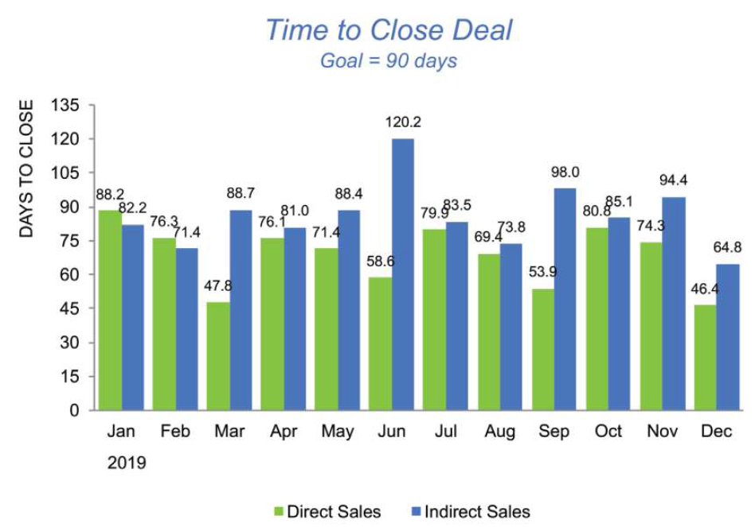

Slide 62
6. “Drag” the labels to the bars
Whenever possible, round the values

Slide 63
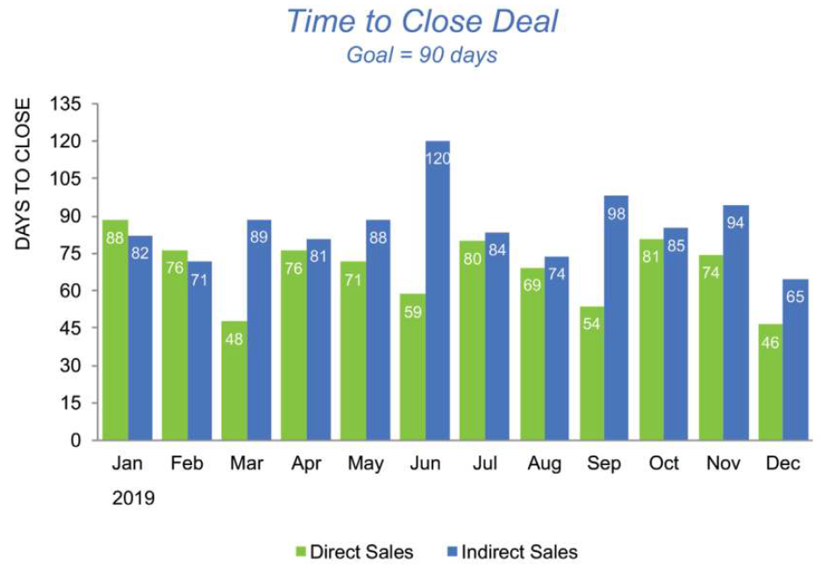

Slide 64
7. Eliminate the data labels
The y axis is redundant with the numbers provided in the labels
Important: remove or not to remove?
It depends on the context:
The exact values are required?
Or the trend is more relevant?

Slide 65
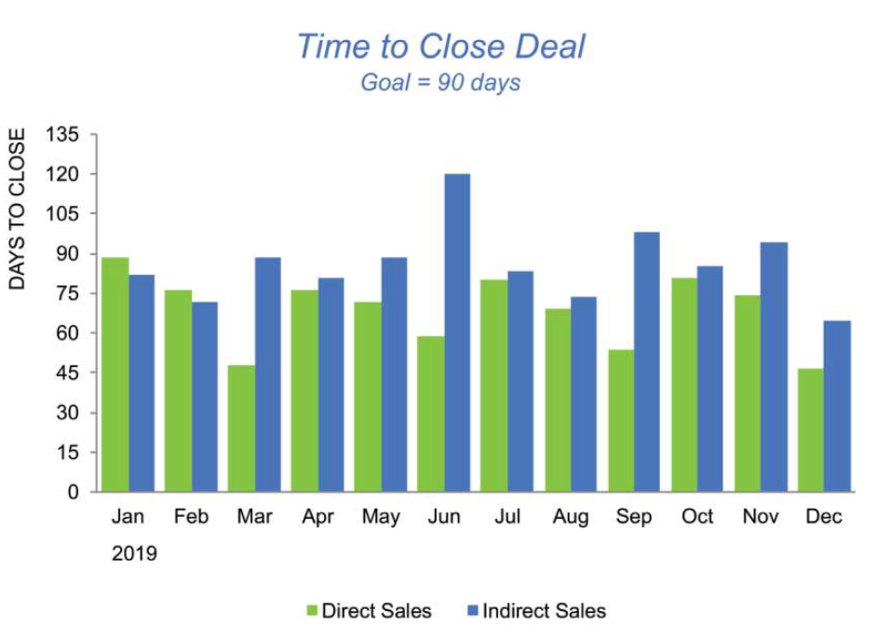

Slide 66
8. Make it a line plot

Slide 67
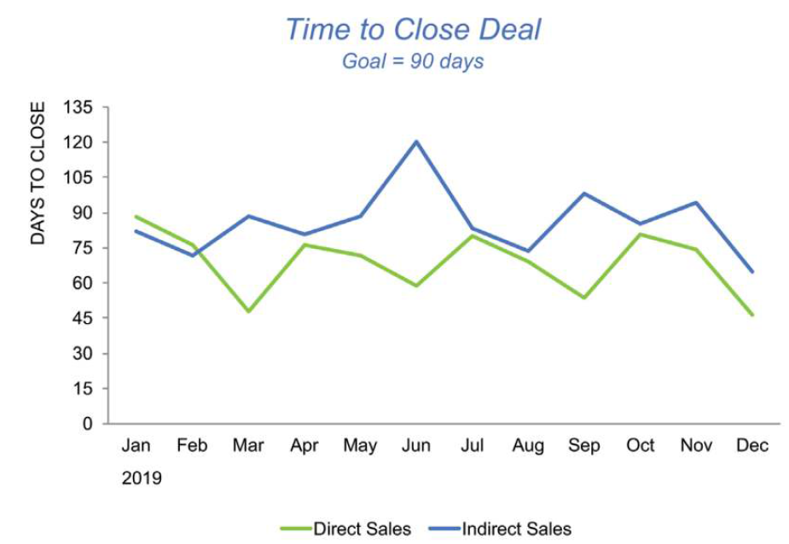

Slide 68
9. Apply the legend to the plot
Using the proximity principle, we can label our lines inside the plot itself

Slide 69
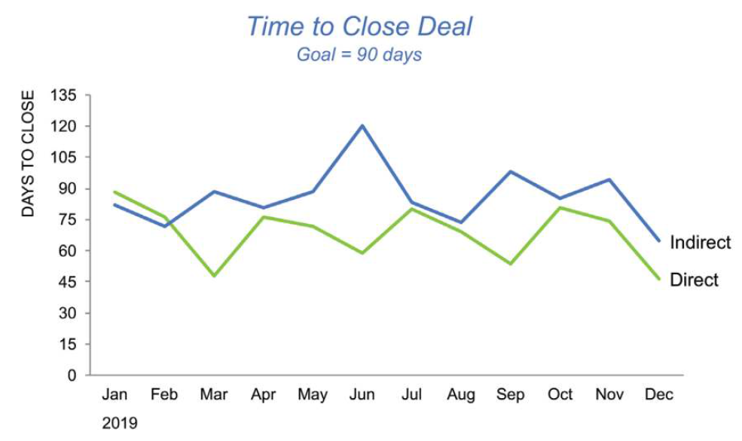

Slide 70
10. Changing the legend color to adhere to the data
Proximity and similarity

Slide 71
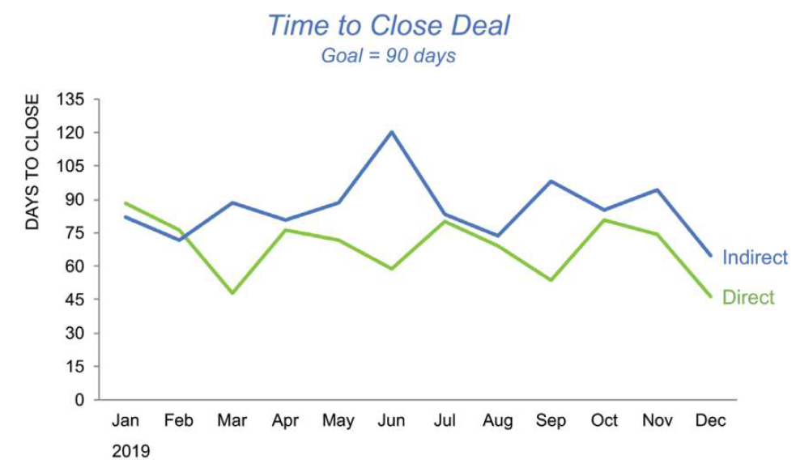

Slide 72
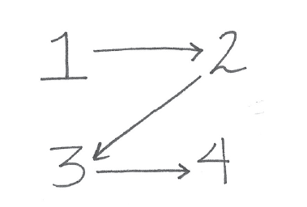
11. Title position
Do not forget how we read (zigzagging z’s):
With this small change, the reader will focus on the title before anything else

Slide 73
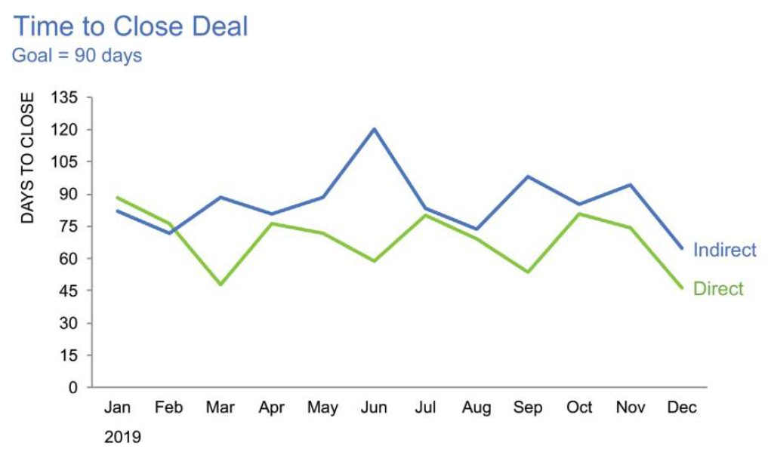

Slide 74
12. Removing the title color
Is the color from the title anyhow related to the “indirect” component?

Slide 75
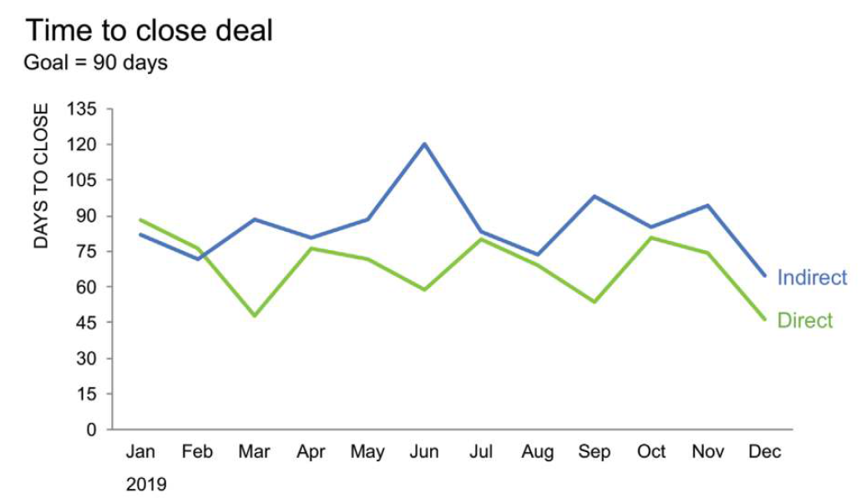

Slide 76
13. Adding the goal to the plot
The goal to make a deal is 90 days
This infromation can be added to the plot to make the analysis of the curves more visual

Slide 77
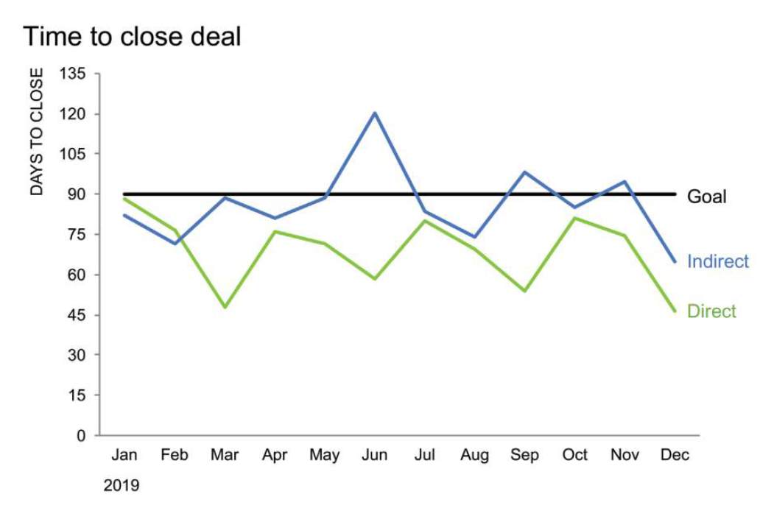

Slide 78
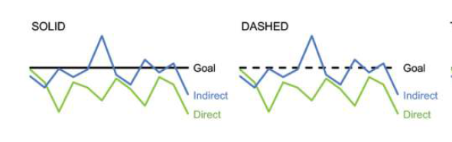
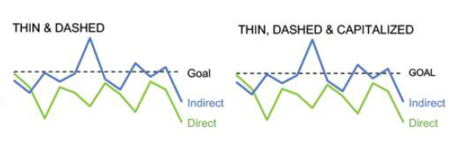
14. Testing different approaches

Slide 79
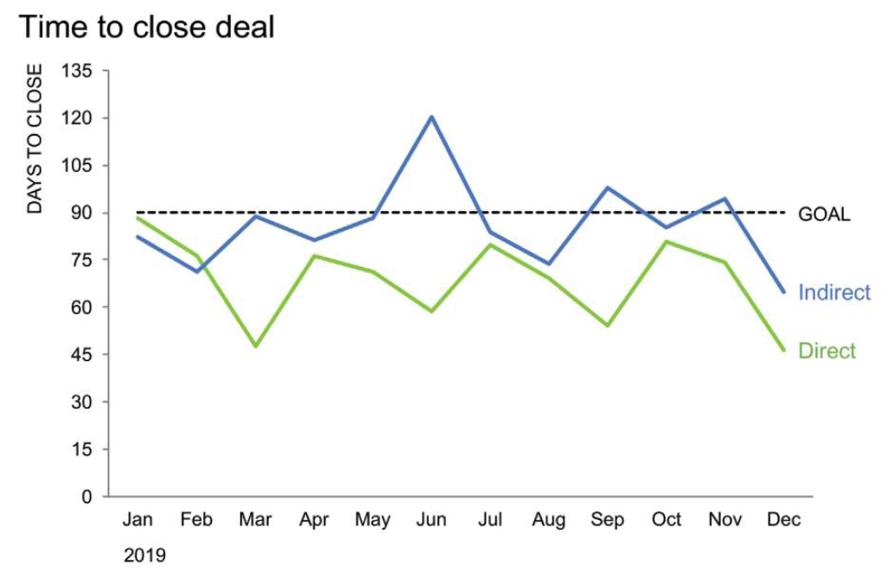

Slide 80
15. Removing colors
We have enough separation between the lines

Slide 81
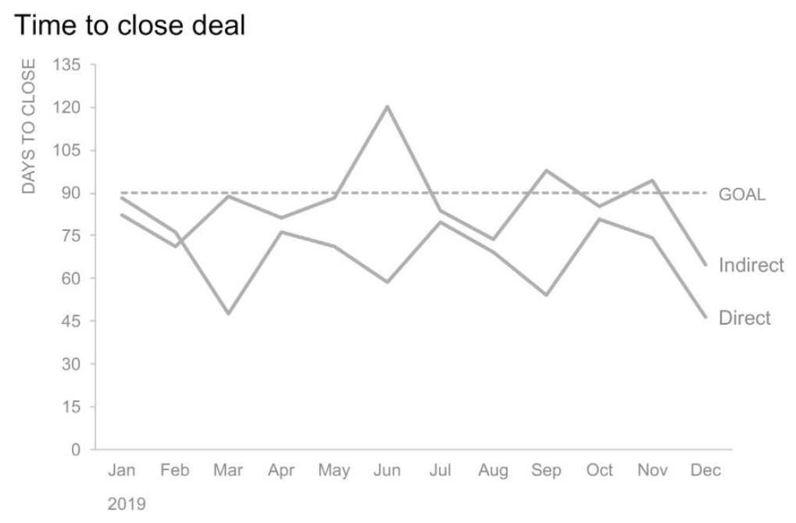

Slide 82
16. Drawing attention
Depending on the audience and goal of the visualization, we may draw the attention to one of the lines

Slide 83
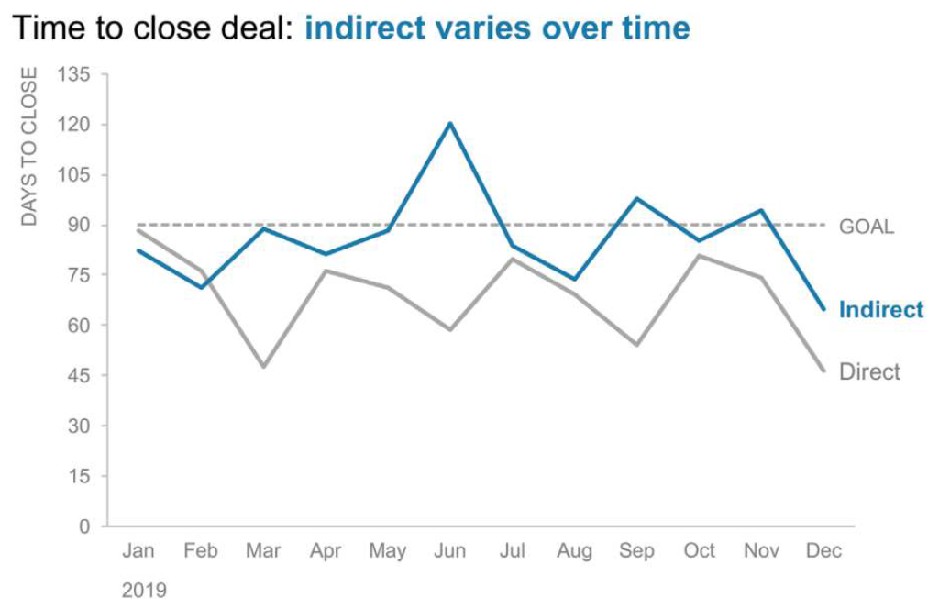

Slide 84
17. Focusing on other aspects
We can focus on other aspects, depending on what we intend to highlight

Slide 85
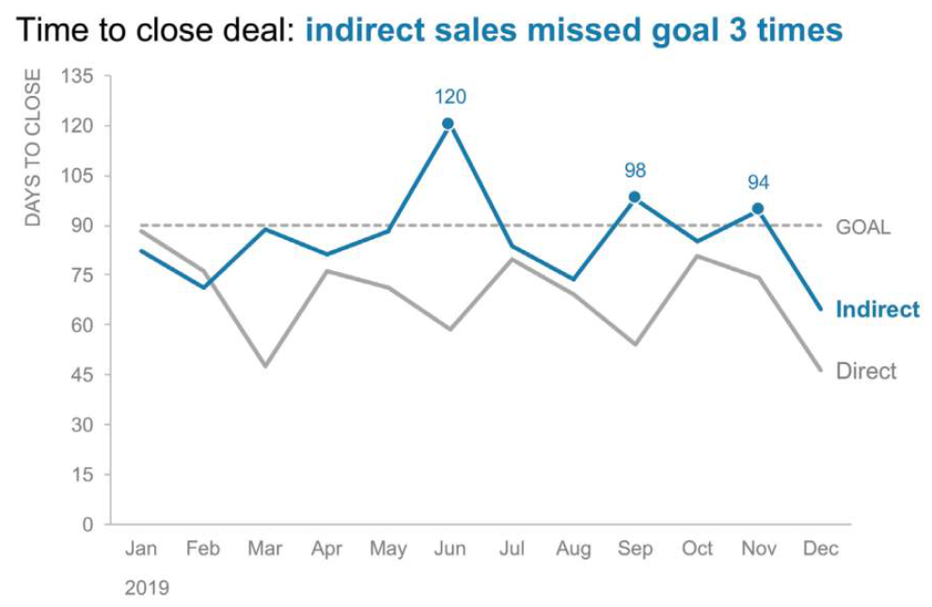

Slide 86
Be mindful of colors

Slide 87
Colors
One of the most commons mistakes in visualizations regards the poor selection of colors
Generally, all visualizations should use 2 colors, unless more are indeed needed
Colors can be used to highlight things
If colors are needed, avoid intense colors
Prefer colors with higher gray values

Slide 88
Color blindness
Keep in mind: approximately 1 in every 8 men and 1 in every 200 women are colorblind!

Slide 89
Color blindness
Online color blindness test:
https://enchroma.com/pages/test
Nice video on how color blindness works:
https://www.youtube.com/watch?v=iNRQB5309yo

Slide 90
Hints
Avoid using red colors and green together.
If you need both together, use another visual component as redundancy
A suggestion is to use orange and blue.

Slide 91
More hints
Avoid the following combinations:
Green and red
Green and brown
Blue and purple
Green and blue
Light green and yellow
Blue and gray
Green and gray
Green and black

Slide 92
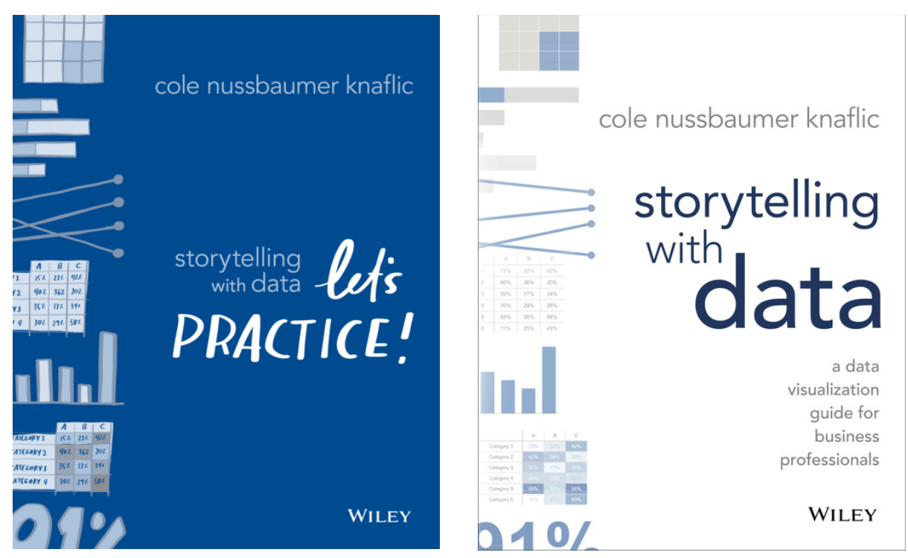
References

Slide 93
Your turn
Gather with your team and continue to work on your project
You should be able to criticize your own visualizations, specially those in the Final Plots section

